Slide 1
Next word predictor

Slide 2
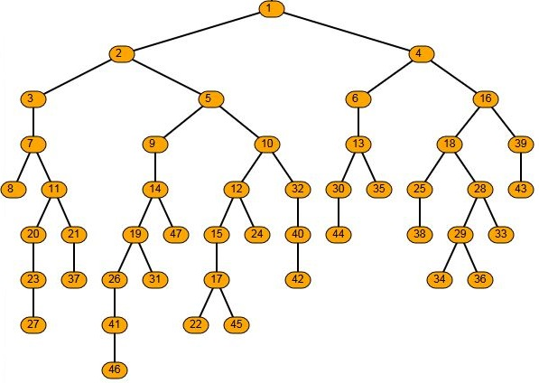
Logic

Slide 3

Database

Slide 4
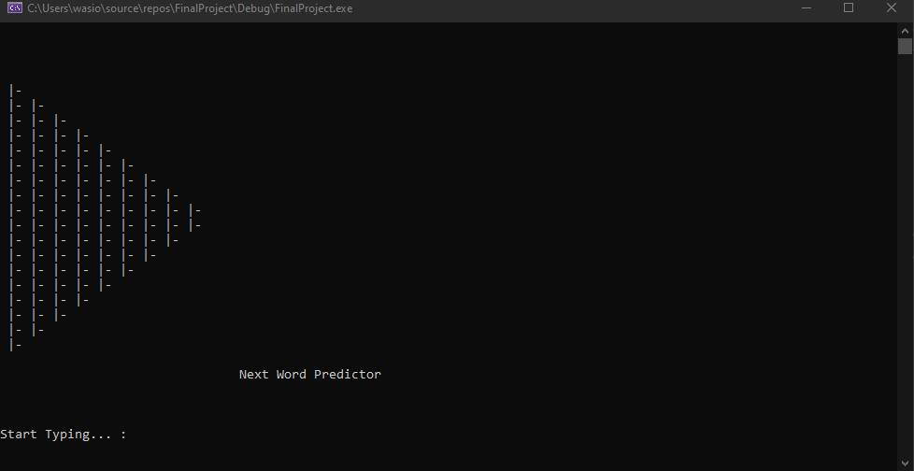
Main screen

Slide 5
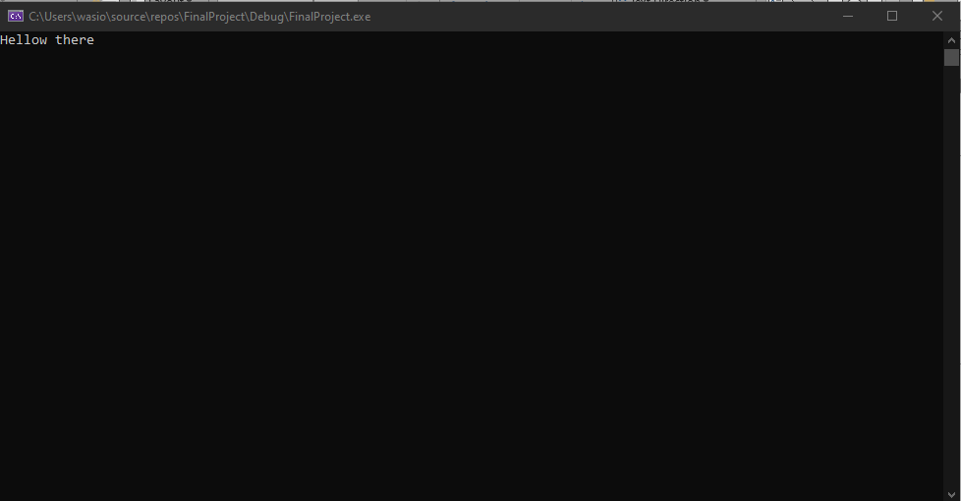
typing

Slide 6
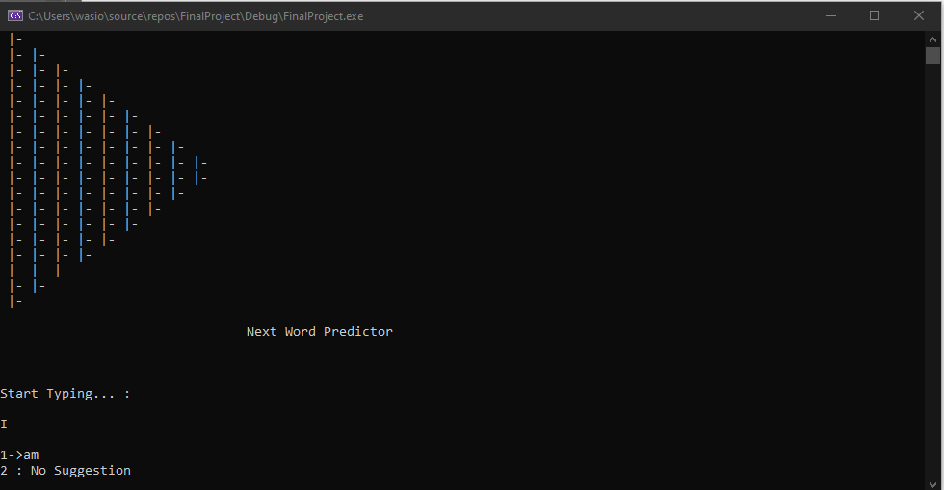
Suggestion

